Slide 1


FitZeal
Field Project review on
Your personalized
Health Tracker
23071A6774- B. Renu Tanmayi
23071A67A5- M. Meghana
23071A67B4- S. Nithya
Project Coordinator:
Mr. R. Sravan
Notes:
Fit+Zeal (enthusiasm)- People may have the will to stay fit, but they often give up halfway. We derived this website’s name by blending the words fit and zeal. ‘Zeal’ means enthusiasm in pursuit of an objective or a cause. So FitZeal is a platform which will provide users the zeal for fitness due to its interactive nature.

Slide 2


ABSTRACT
Track water intake, sleep, and meals daily.
Calculate calories based on user input.
Get personalized exercise recommendations instantly.
Suggest healthy recipes using available ingredients.
Easy-to-use, interactive, and engaging interface.
A holistic health management tool for everyone.

Slide 3

INTRODUCTION
Combines multiple health tracking features into a single, user-friendly platform.
Focuses on habit formation rather than short-term tracking.
Prioritizes actionable insights to help users achieve holistic wellness.
Ensures data security and efficient management for a seamless experience.
Employs a future-ready design with room for feature expansion.
Encourages proactive health awareness through personalized suggestions.

Slide 4
METHODOLOGY
Architecture: Client-server model with a React.js frontend, Node.js backend, and MySQL database for centralized data storage.
Frontend: Interactive UI with features like calorie tracking, sleep analysis, and water intake tracking, designed with a purple theme for branding.
Backend: Built using Node.js, handling business logic, user authentication, and database communication.
Database: Normalized tables with primary and foreign keys for data integrity, storing user data, food items, and tracking records.

Slide 5
Data Persistence: Utilized LocalStorage for temporary session data and ensured long-term data is stored in the database.
User Experience: Intuitive design with large inputs, visual graphs, and seamless navigation for tracking features.
Development: Modular approach dividing frontend, backend, and database tasks, with iterative testing for integration.

Slide 6
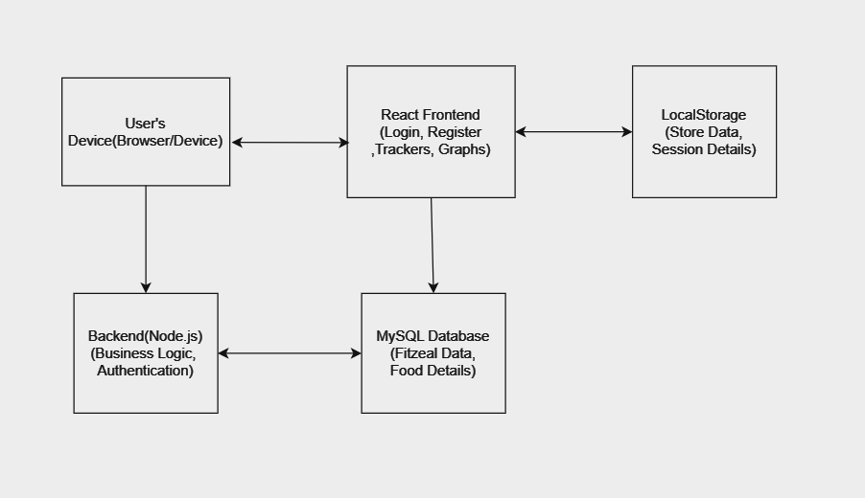
ARCHITECTURE DIAGRAM:

Slide 7
Software Requirements
FRONTEND
HTML, CSS, JavaScript
Features:
Input Forms: Simple forms to input water intake, food intake, and sleep data.
Display: Sections to display the total calories consumed, recommended exercises, and healthy recipes.
Basic Styling: Use plain CSS for styling to keep the design simple and user-friendly.

Slide 8
Software Requirements
BACKEND
Languages: SQL,Javascript
Database: MySQL for storing user data like name,mail,password and for storing recipes, ingredients.
Data Processing: Basic algorithms to calculate total calorie consumption and match exercises and recipes with user data.
Backend Framework: Node.js

Slide 9
Hardware Requirements
A computer or laptop with a minimum of 8GB RAM for smooth development and testing.
At least 20GB free space to accommodate the development environment, database, and application files.
Internet connectivity for accessing external libraries, tools, and database setup..

Slide 10
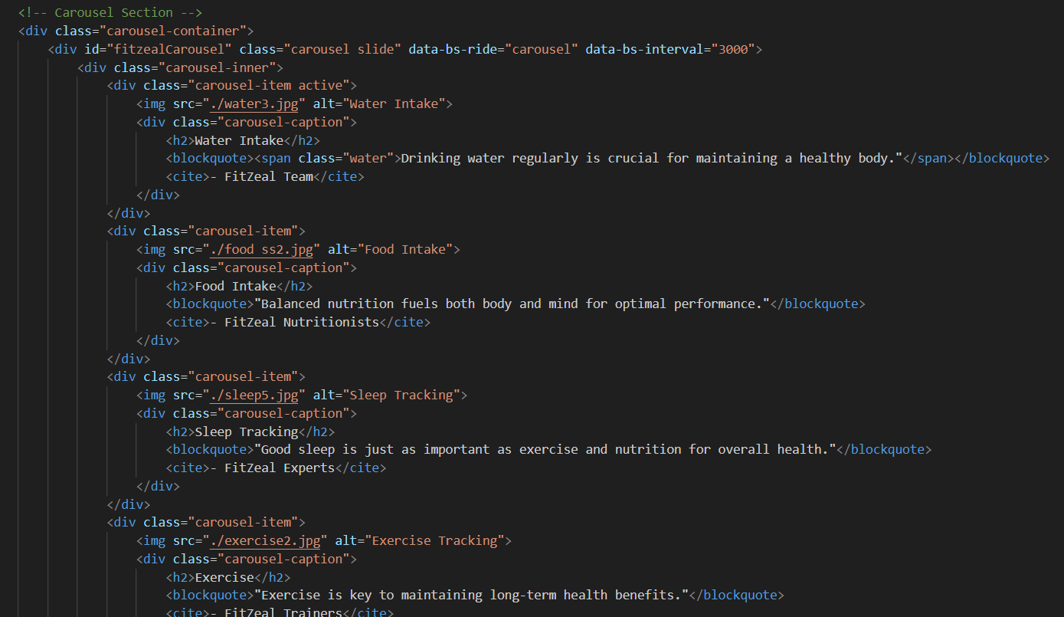
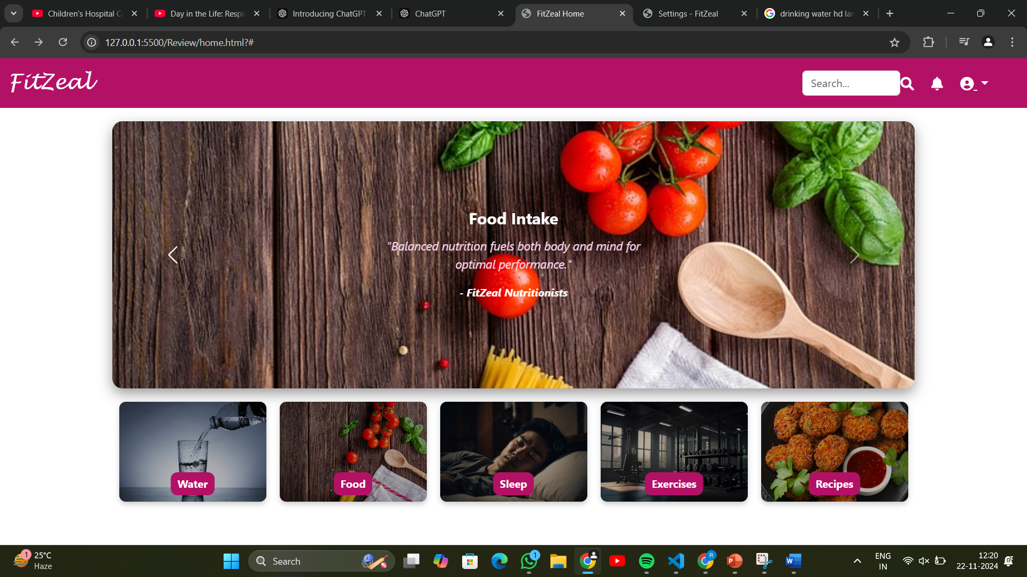
CODING AND RESULTS:
Home Page

Slide 11
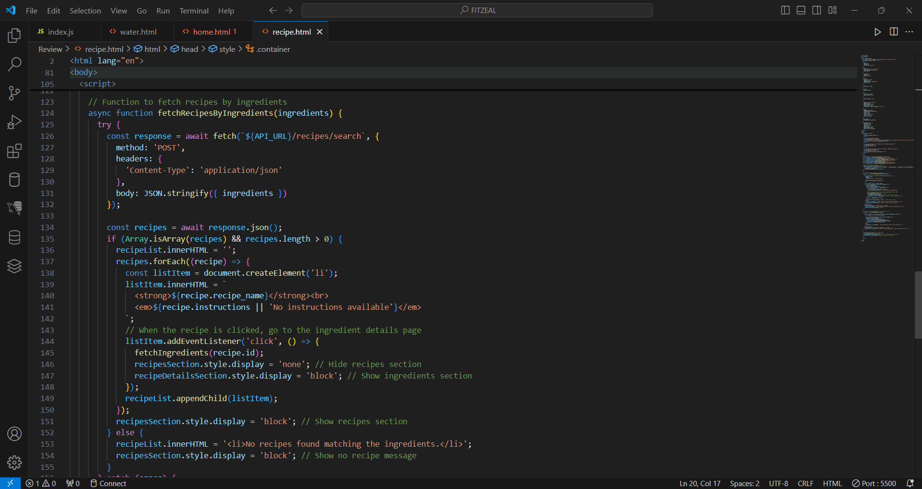
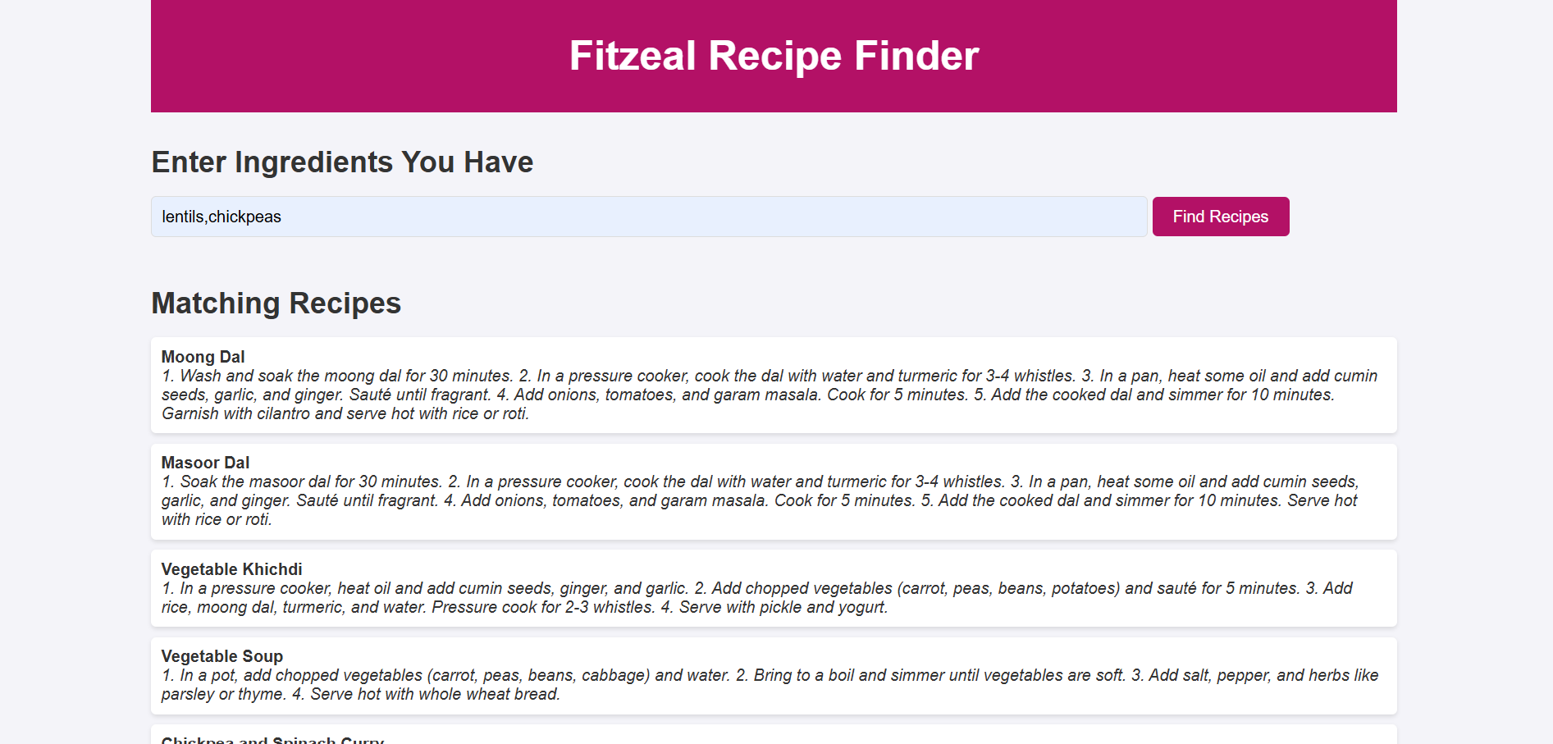
CODING AND RESULTS:
Recipe Recommendation

Slide 12
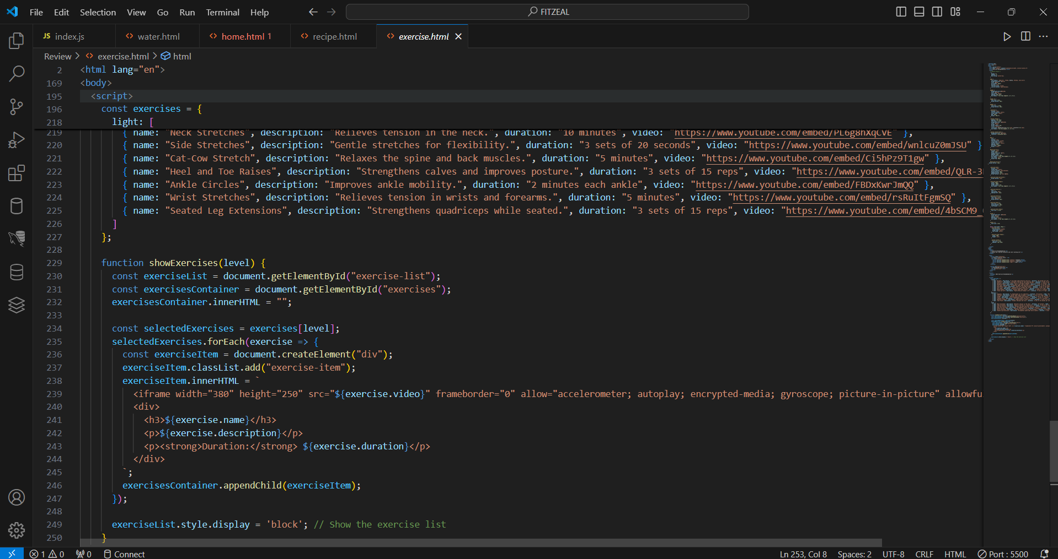
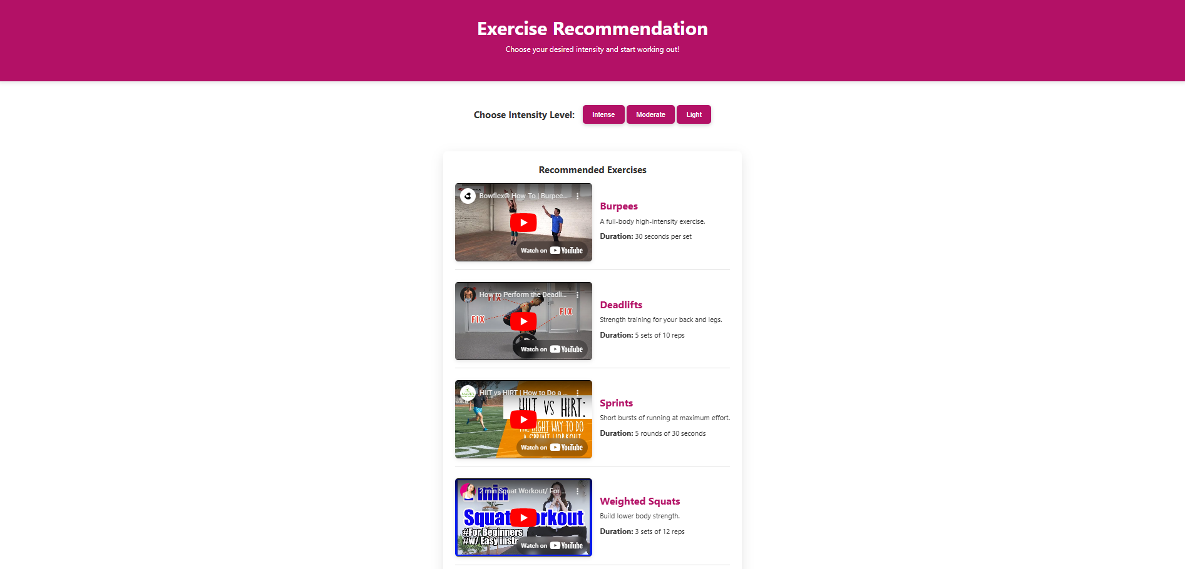
CODING AND RESULTS:
Exercise Recommendation

Slide 13

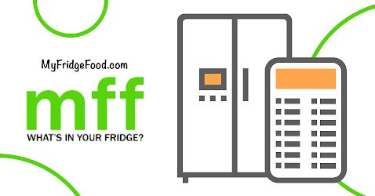
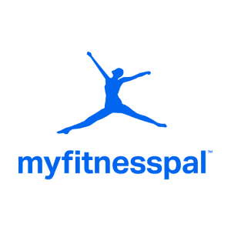

What makes FitZeal Unique
Drawbacks of other websites:
Websites like Yummly, Foodcombo and MyFridgeFood recommend recipes based on the ingredients provided but do not consider calorie intake.
Websites like MyFitnessPal recommends exercises and tracks calories, but it does not suggest any healthy recipes based on the ingredients we have.
So, our focus here is to integrate both the above features into one platform, which no other website has accomplished till now as far as we know.

Slide 14
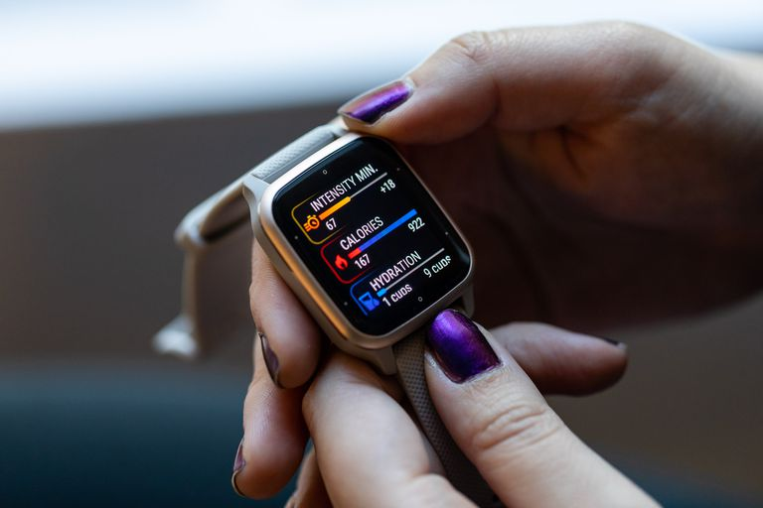
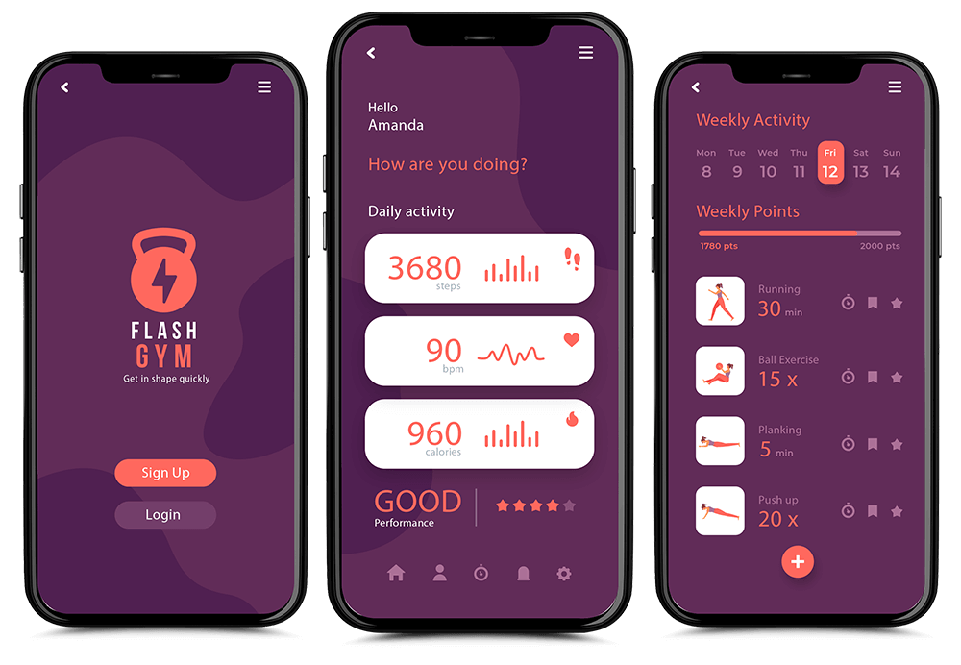
FUTURE SCOPE
Integration with wearable devices like Fitbit and Apple Watch to automate data collection (steps, heart rate, sleep, etc.).
Implement AI algorithms for smarter, personalized fitness, diet, and wellness suggestions based on user behavior.
Expand the food database to include a larger variety of foods with accurate calorie and nutritional information.
Add real-time tracking for workouts (running, cycling, gym exercises) with performance metrics and goal tracking.
Develop a mobile app for enhanced accessibility and user engagement on the go.
Introduce community features for users to connect, share progress, and motivate each other in their wellness journeys.

Slide 15
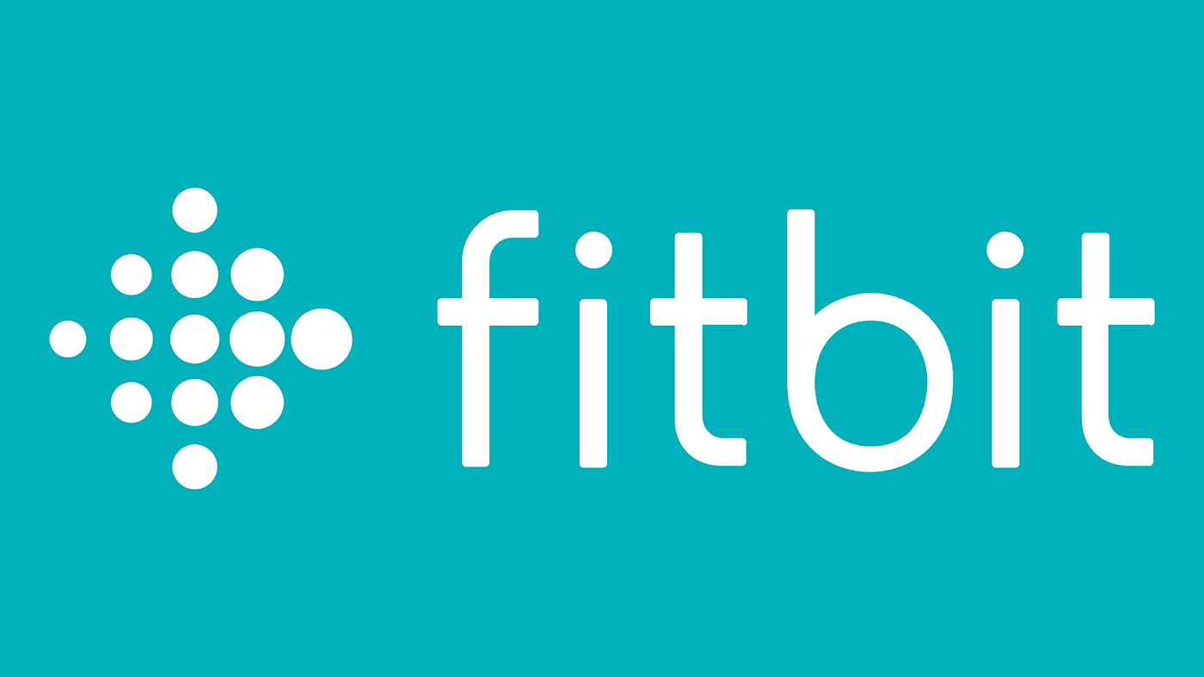
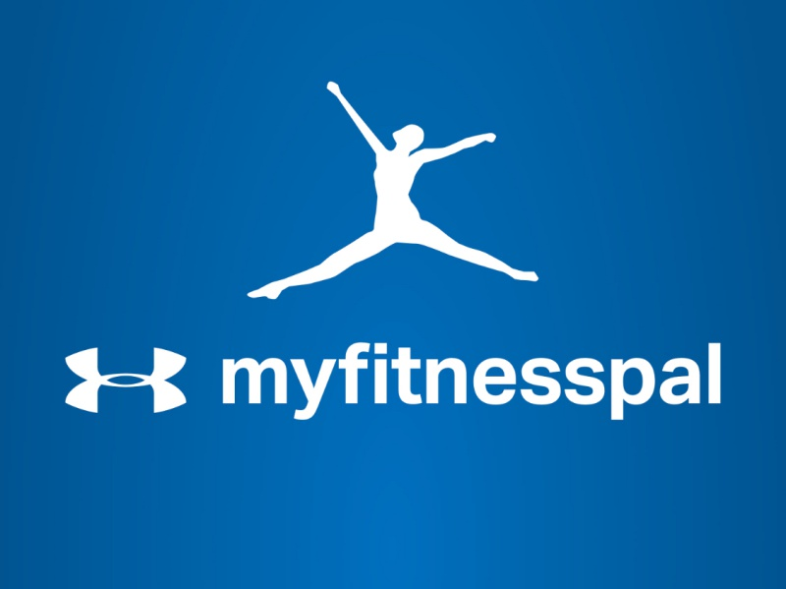
REFERENCES
Case Studies and Examples
Fitbit Success Stories: Explore how users achieve their fitness goals.
https://community.fitbit.com/t5/Manage-Weight/Success-Stories/td-p/160007
MyFitnessPal Case Study: Insights into user engagement and calorie tracking
https://www.myfitnesspal.com/
Journal Articles
“Examining the impacts of fitness app features on user well-being”
https://www.sciencedirect.com/science/article/abs/pii/S0378720623000447#:~:text=We%20show%20that%20personal%2Doriented,outcomes%20in%20a%20nuanced%20manner.
"Calorie counting smart phone apps: Effectiveness in nutritional awareness, lifestyle modification and weight management among young Indian adults:
https://www.researchgate.net/publication/333777044_Calorie_counting_smart_phone_apps_Effectiveness_in_nutritional_awareness_lifestyle_modification_and_weight_management_among_young_Indian_adults

Slide 16
THANK YOU
23071A6774- B. Renu Tanmayi
23071A67A5- M. Meghana
23071A67B4- S. Nithya

